Slide 1
Logistic Regression Models in SPSS AND PSPP
Richard Lee Rogers
Last Update: February 27, 2016

Slide 2
Example

Slide 3
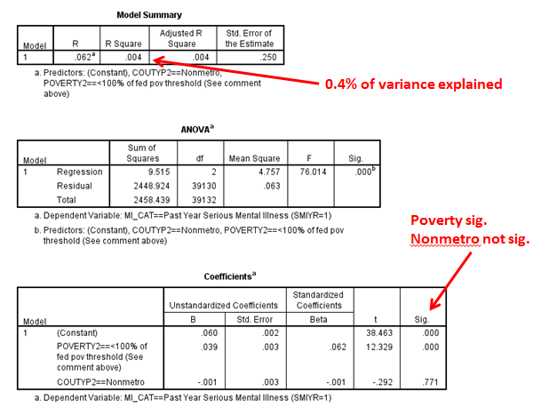
OLS Regression

Slide 4
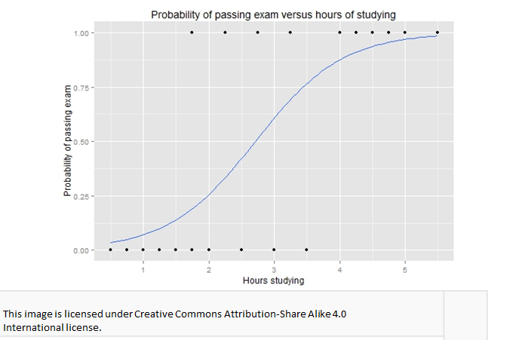
S-Shaped Curve

Slide 5
The Log Odds Ratio
P(t) = ln (p / (1-p) )

Slide 6
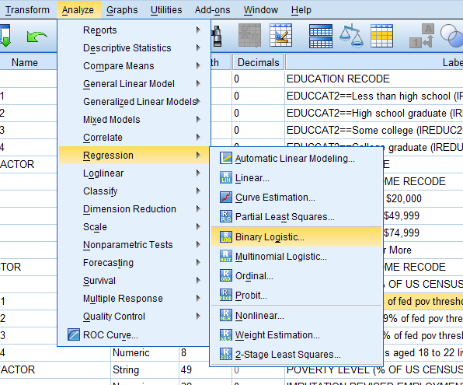
SPSS: Analyze > Regression > Binary Logistic

Slide 7
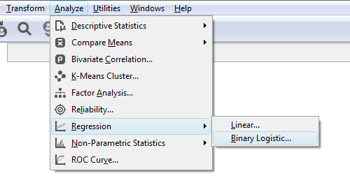
PSPP: Analyze > Regression > Binary Logistic

Slide 8
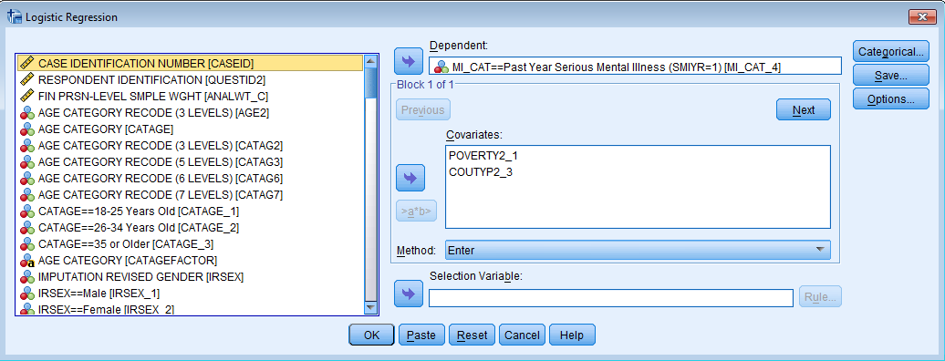
SPSS Command Dialog Box

Slide 9
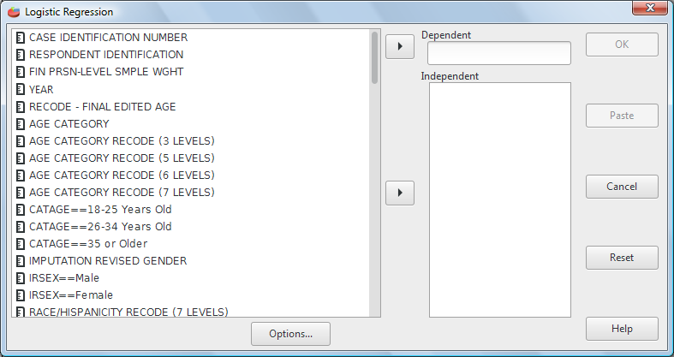
PSPP Command Dialog Box

Slide 10
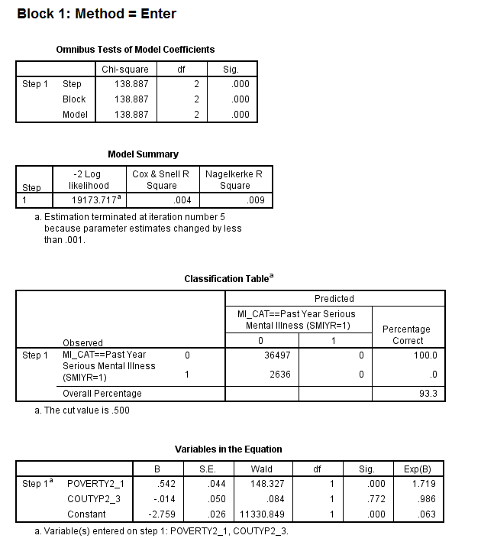
Output

Slide 11
Variables in the Equation

Slide 12
Interpreting Odds Ratios
1.72—The event is 1.72X more likely to occur relative to the reference category or 72% higher (1.72-1.00=.72)
1.00 – there is no relationship (null hypothesis)
0.99 – The event is 1% less likely to occur (1.00-.99=.01)

Slide 13
Additional Comments
Odds ratios are relative, not absolute or standardized numbers.
Categories with three or more variables can be used as dummy variables.
Both categorical and numeric variables can be used as independent variables, but it is preferable to create categories out of numeric variables if the coefficients for numeric variables are too small.

Slide 14
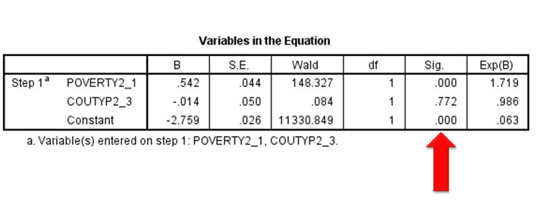
Statistical Significance

Slide 15
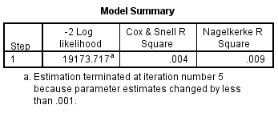
Model Summary

Slide 16
Log Likelihood Function
ln L = Σ (y_{t}ln(1/(1+e^{-t})))+(1-y_{t})ln(1-1/(1+e^{-t}))

Slide 17
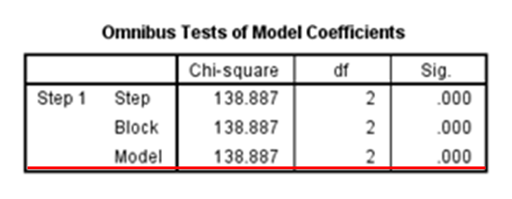
Omnibus Tests of Model Coefficients

Slide 18
Pseudo R²

Slide 19
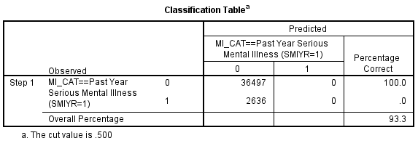
Classification Table

Slide 20
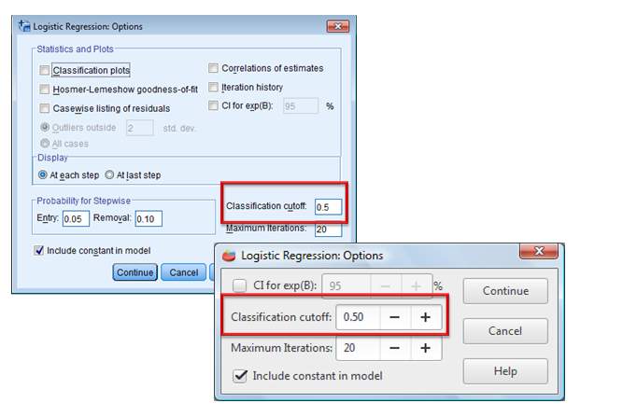
Options

Slide 21
New Classification Table

Slide 22
Debate Over Cut Points
Drug trials might prefer to keep the .5 cutoff point.
Social sciences might prefer to change the cutoff.
Statisticians may apply even other tests to maximize the sensitivity and specificity.

Slide 23
Summary
Direction: Sign of B
Magnitude
Beta (unstandardized)
Odds ratio (relative)
No standardized magnitude
Statistical significance
Model performance
Pseudo R² (relative)
Classification table (unstandardized)

Slide 24
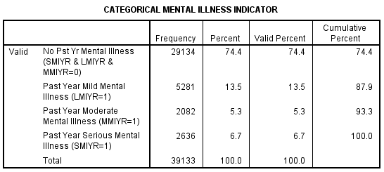
Additional Models

Slide 25
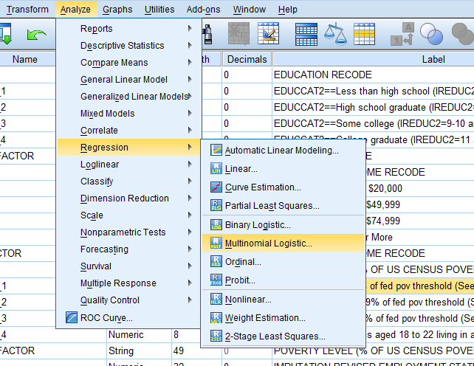
Analyze > Regression > Multinomial Logistic

Slide 26
Multinomial Parameter Estimates

Slide 27
Multinomial Odds Ratios
 | No Past vs. Serious | Mild vs. Serious | Moderate vs. Serious
Poverty | .539* | .755* | .793*
Non-Metro | 1.011 | 1.015 | 1.064
Note: * p<.05

Slide 28
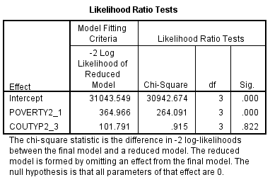
Multinomial Model Performance

Slide 29
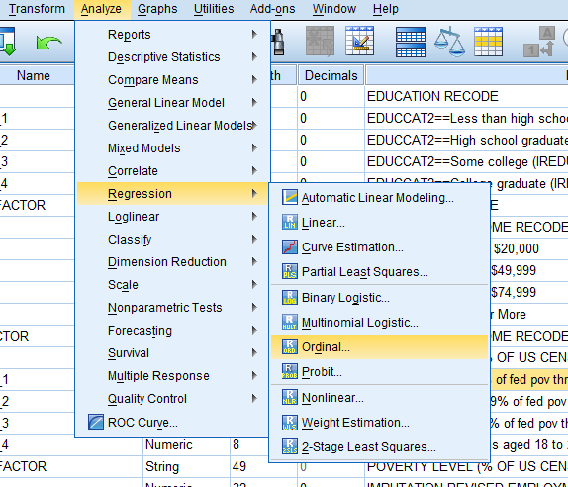
Analyze > Regression > Ordinal

Slide 30
Ordinal Parameter Estimates

Slide 31
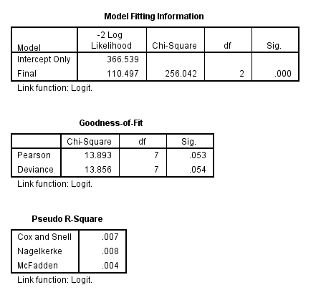
Ordinal Output

Slide 32
The End
Binary logistic regression
Multinomial logistic regression
Ordinal logistic regression

