Slide 1
THE ANALYSIS OF CONTINGENCY TABLES IN SPSS
Richard Lee Rogers

Slide 2
In this Presentation
Contingency tables are used when both variables are categorical.
Direction (?): Table should be visually inspected to make sure we understand meaning of results.
Chi-square (χ² ) is used to determine whether deviations from the random distribution of observations in cells of the table are statistically significant.
Gamma (γ) and Kendall’s tau-b give direction and effect size when both variables are ordinal or binary.
Phi ($∅)$and Cramer’s V give effect size when at least one variable is nominal.

Slide 3
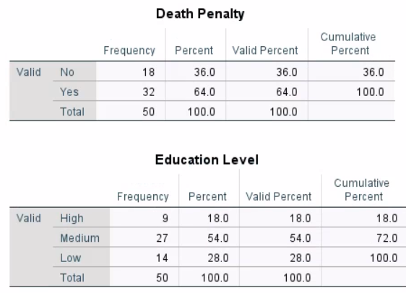
Example
Education Policy on Death Penalty
Death
Penalty
0=No
1=Yes
Education
Level
1=High
2=Medium
3=Low

Slide 4
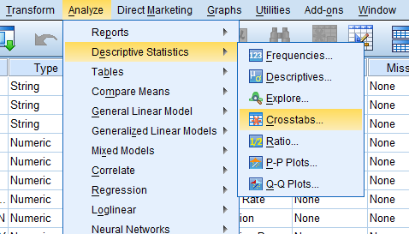
Analyze > Descriptive Statistics> Crosstabs

Slide 5
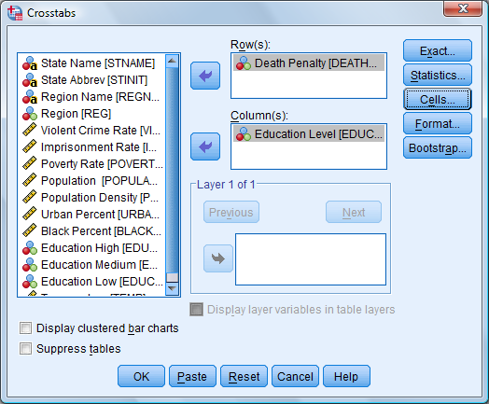
Command Dialog Box

Slide 6
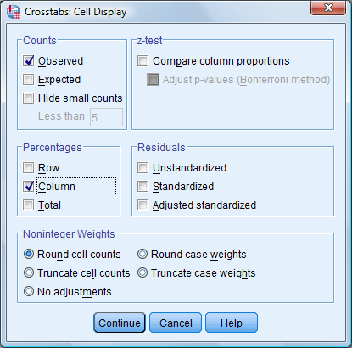
Command Dialog Box

Slide 7
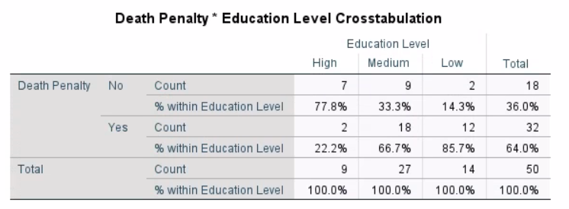
Crosstab

Slide 8
Crosstab: Marginals

Slide 9
Crosstab: Grand Total

Slide 10
Crosstab: Column

Slide 11
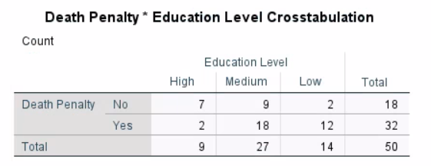
Crosstabs without Column Percents

Slide 12
Crosstab: Eyeballing

Slide 13
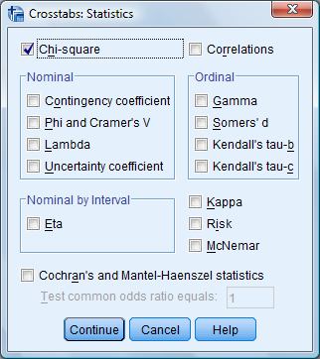
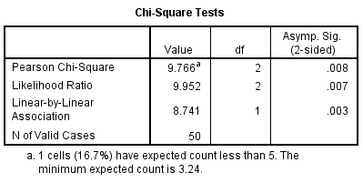
Chi-Square Output

Slide 14
Chi-Square Output

Slide 15
Formula
χ² = $\sum{\frac{\text{(}\text{Observed}i\text{−}\text{Expected}i\text{)}\text{2} }{\text{Expected}i}}$

Slide 16
Calculating the Expected Value: 1. Start with the Marginals of the Table
EXPECTED | Education
Death Penalty | High | Medium | Low | Total
No |  |  |  | 18
Yes |  |  |  | 32
Total | 9 | 27 | 14 | 50
EXPECTED | Education
Death Penalty | High | Medium | Low | Total
No |  |  |  | 18
Yes |  |  |  | 32
Total | 9 | 27 | 14 | 50

Slide 17
Calculating the Expected Value: 2. Calculate Random Distribution of Data Assuming Marginals
EXPECTED | Education
Death Penalty | High | Medium | Low | Total
No |  |  |  | 18
Yes |  |  |  | 32
Total | 9 | 27 | 14 | 50
Let i = row
Let j = columns
Cell_{ij} = (marginal_{i} X marginal_{j}) / N

Slide 18
Calculating the Expected Value: 2. Calculate Random Distribution of Data Assuming Marginals
EXPECTED | Education
Death Penalty | High | Medium | Low | Total
No | $\frac{18 X 9}{50}$ | $\frac{18 X 27}{50}$ | $\frac{18 X 14}{50}$ | 18
Yes | $\frac{32 X 9}{50}$ | $\frac{32 X 27}{50}$ | $\frac{32 X 14}{50}$ | 32
Total | 9 | 27 | 14 | 50
Let i = row
Let j = columns
Cell_{ij} = (marginal_{i} X marginal_{j}) / N

Slide 19
The Two Tables
OBSERVED | Education
Death Penalty | High | Medium | Low | Total
No | 7 | 9 | 2 | 18
Yes | 2 | 18 | 12 | 32
Total | 9 | 27 | 14 | 50
EXPECTED | Education
Death Penalty | High | Medium | Low | Total
No | 3.2 | 9.7 | 5.0 | 18
Yes | 5.8 | 17.3 | 9.0 | 32
Total | 9 | 27 | 14 | 50

Slide 20
Calculating the Expected Value: 3. Apply the Chi-Square Formula
χ² = $\sum{\frac{\text{(}\text{Observed}i\text{−}\text{Expected}i\text{)}\text{2} }{\text{Expected}i}}$ =
$\frac{\left(7−3.2\right)2}{3.2}$ + $\frac{(9−9.7)2}{9.7}$ + $\frac{(2−5.0)2}{5.0}$ +
$\frac{(2−5.8)2}{5.8}$ + $\frac{(18−17.3)2}{17.3}$ + $\frac{(12−9.0)2}{9.0}$ = 9.766

Slide 21
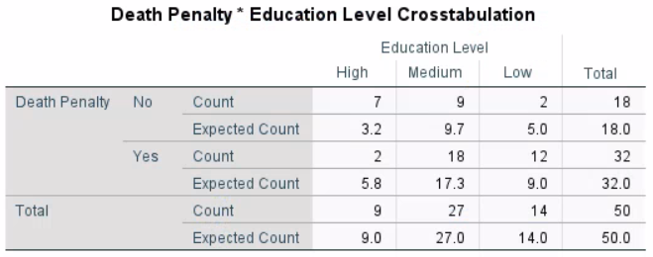
A Warning

Slide 22
Formula
χ² = $\sum{\frac{\text{(}\text{Observed}i\text{−}\text{Expected}i\text{)}\text{2} }{\text{Expected}i}}$

Slide 23
Calculating the Expected Value: 4. Determine the Degrees of Freedom
d.f.=(rows-1)(columns-1)

Slide 24
Calculating the Expected Value 4. Determine the Degrees of Freedom
d.f.=(rows-1) X (columns-1) = (2-1) X (3-1) = 2

Slide 25
Calculating the Expected Value 4. Determine the Degrees of Freedom
d.f.=(rows-1) X (columns-1) = (2-1) X (3-1) = 2
Conclusion: We have a chi-square statistic of 9.667 with 2 degrees of freedom.

Slide 26
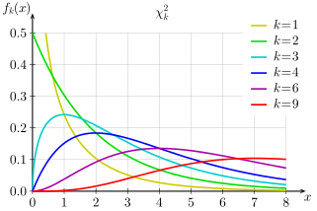
The χ² Distribution
Source: Wikipedia. Used under Creative Commons Attribution 3.0 Unported license.

Slide 27
The χ² Distribution
Probability of exceeding the critical value
0.10 0.05 0.025 0.01 0.001
1 2.706 3.841 5.024 6.635 10.828
2 4.605 5.991 7.378 9.210 13.816
3 6.251 7.815 9.348 11.345 16.266
4 7.779 9.488 11.143 13.277 18.467
5 9.236 11.070 12.833 15.086 20.515
6 10.645 12.592 14.449 16.812 22.458
7 12.017 14.067 16.013 18.475 24.322
8 13.362 15.507 17.535 20.090 26.125
9 14.684 16.919 19.023 21.666 27.877
10 15.987 18.307 20.483 23.209 29.588
Source: Wikipedia. Used under Creative Commons Attribution 3.0 Unported license.

Slide 28
The χ² Distribution
Probability of exceeding the critical value
0.10 0.05 0.025 0.01 0.001
1 2.706 3.841 5.024 6.635 10.828
2 4.605 5.991 7.378 9.210 13.816
3 6.251 7.815 9.348 11.345 16.266
4 7.779 9.488 11.143 13.277 18.467
5 9.236 11.070 12.833 15.086 20.515
6 10.645 12.592 14.449 16.812 22.458
7 12.017 14.067 16.013 18.475 24.322
8 13.362 15.507 17.535 20.090 26.125
9 14.684 16.919 19.023 21.666 27.877
10 15.987 18.307 20.483 23.209 29.588
Source: Wikipedia. Used under Creative Commons Attribution 3.0 Unported license.

Slide 29
Additional Statistics Give Effect Size and Direction
Both variables ordinal or binary: gamma (ɣ) or Kendall’s tau-b
At least one variable nominal: Phi ($∅)$or Cramer’s V

Slide 30
Gamma, Kendall’s tau-b, Phi, and Cramer’s V Effect Sizes
<.10 No relationship
.10 to .29 Weak
.30 to .49 Moderate
.50 to 1.00 Strong

Slide 31
Gamma (ɣ)
Adds effect size and direction
Used when both variables are ordinal or binary
Let P=positive ties
Let N=negative ties
Formula: $\frac{\text{P}\text{−}\text{N}}{\text{P}\text{+}\text{N}}$
P=(7 X 18) + (7 X 12) + (9 X 12) = 318
N=(2 X 9) + (2 X 2) + (18 X 2) = 58
ɣ = $\frac{\text{318 − 58}}{\text{31}\text{8 + }\text{5}\text{8}}$ ≈ .69
OBSERVED | Education
Death Penalty | High | Medium | Low
No | 7 | 9 | 2
Yes | 2 | 18 | 12

Slide 32
Gamma (ɣ)
Adds effect size and direction
Used when both variables are ordinal or binary
Let P=positive ties
Let N=negative ties
Formula: $\frac{\text{P}\text{−}\text{N}}{\text{P}\text{+}\text{N}}$
P=(7 X 18) + (7 X 12) + (9 X 12) = 318
N=(2 X 9) + (2 X 2) + (18 X 2) = 58
ɣ = $\frac{\text{318}\text{ − 58}}{\text{31}\text{8 + }\text{5}\text{8}}$ ≈ .69
OBSERVED | Education
Death Penalty | High | Medium | Low
No | 7 | 9 | 2
Yes | 2 | 18 | 12

Slide 33
Gamma (ɣ)
Adds effect size and direction
Used when both variables are ordinal or binary
Let P=positive ties
Let N=negative ties
Formula: $\frac{\text{P}\text{−}\text{N}}{\text{P}\text{+}\text{N}}$
P=(7 X 18) + (7 X 12) + (9 X 12) = 318
N=(2 X 9) + (2 X 2) + (18 X 2) = 58
ɣ = $\frac{\text{318 − 58}}{\text{31}\text{8 + }\text{5}\text{8}}$ ≈ .69
OBSERVED | Education
Death Penalty | High | Medium | Low
No | 7 | 9 | 2
Yes | 2 | 18 | 12

Slide 34
Gamma (ɣ)
Adds effect size and direction
Used when both variables are ordinal or binary
Let P=positive ties
Let N=negative ties
Formula: $\frac{\text{P}\text{−}\text{N}}{\text{P}\text{+}\text{N}}$
P=(7 X 18) + (7 X 12) + (9 X 12) = 318
N=(2 X 9) + (2 X 2) + (18 X 2) = 58
ɣ = $\frac{\text{318 − 58}}{\text{31}\text{8 + }\text{5}\text{8}}$ ≈ .69
OBSERVED | Education
Death Penalty | High | Medium | Low
No | 7 | 9 | 2
Yes | 2 | 18 | 12

Slide 35
Gamma (ɣ)
Adds effect size and direction
Used when both variables are ordinal or binary
Let P=positive ties
Let N=negative ties
Formula: $\frac{\text{P}\text{−}\text{N}}{\text{P}\text{+}\text{N}}$
P=(7 X 18) + (7 X 12) + (9 X 12) = 318
N=(2 X 9) + (2 X 2) + (18 X 2) = 58
ɣ = $\frac{\text{318 − 58}}{\text{31}\text{8 + }\text{5}\text{8}}$ ≈ .69
OBSERVED | Education
Death Penalty | High | Medium | Low
No | 7 | 9 | 2
Yes | 2 | 18 | 12

Slide 36
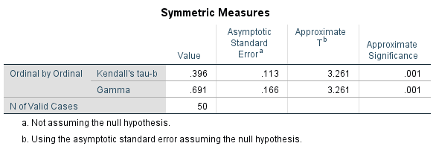
Gamma (ɣ) and Kendall’s tau-b Output

Slide 37
Gamma (ɣ) and Kendall’s tau-b Output

Slide 38
Effect Size: Phi and Cramer’s V
2 X 2 table: Phi
$$∅= \sqrt{{X2}/n}$$
Other tables: Cramer’s V
$$V= \sqrt{{X2}/{(n−df)}}$$

Slide 39
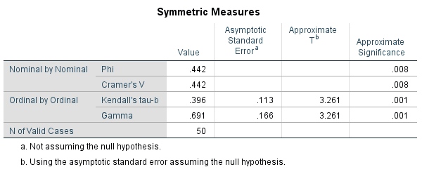

Slide 40
The End
Contingency tables are used when both variables are categorical.
Direction (?): Table should be visually inspected to make sure we understand meaning of results.
Chi-square (χ² ) is used to determine whether deviations from the random distribution of observations in cells of the table are statistically significant.
Gamma (γ) and Kendall’s tau-b give direction and effect size when both variables are ordinal or binary.
Phi ($∅)$and Cramer’s V give effect size when at least one variable is nominal.

