Slide 1
Summarizing Descriptive Statistics in an APA-style Table
Richard Lee Rogers
September 4, 2018

Slide 2
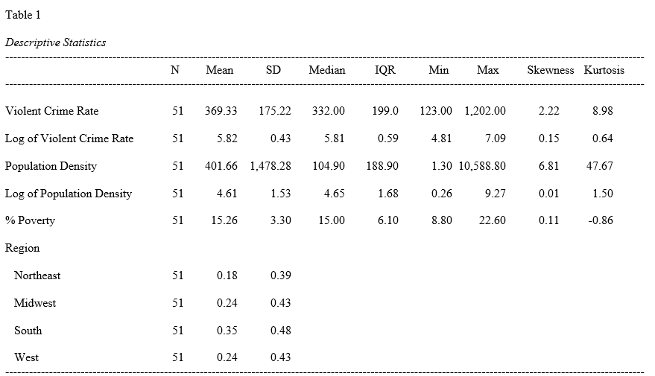
APA-style Table

Slide 3
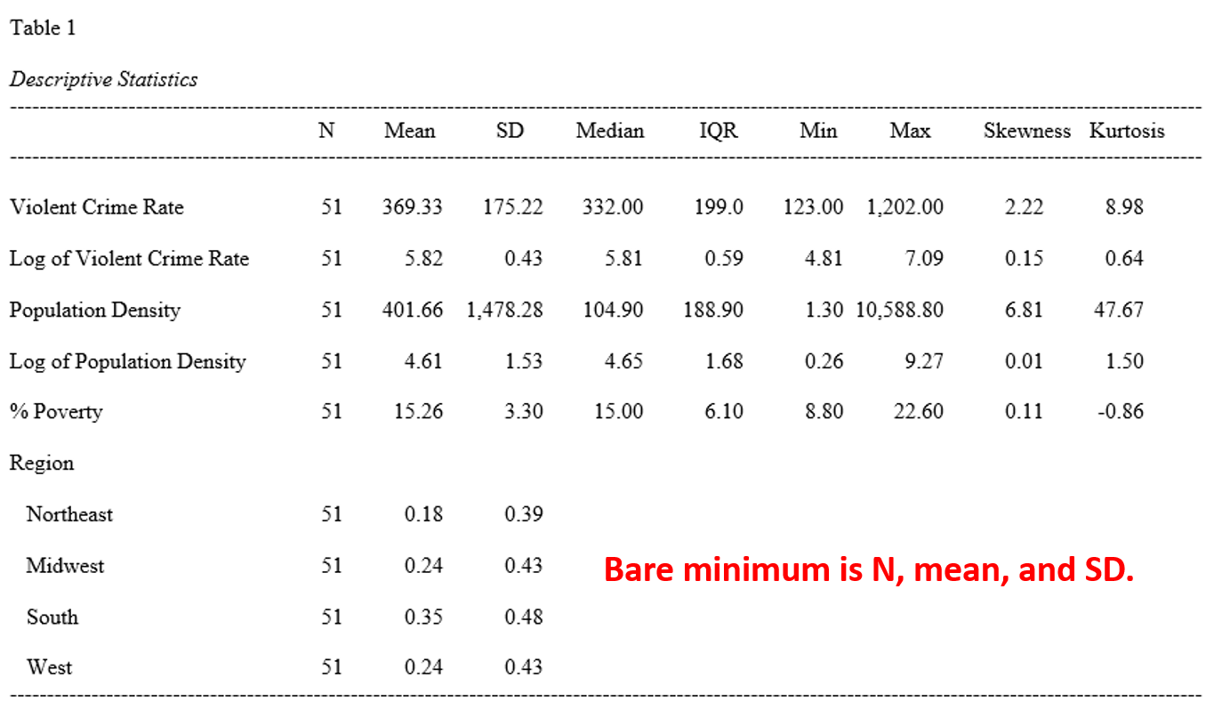
APA-style Table

Slide 4
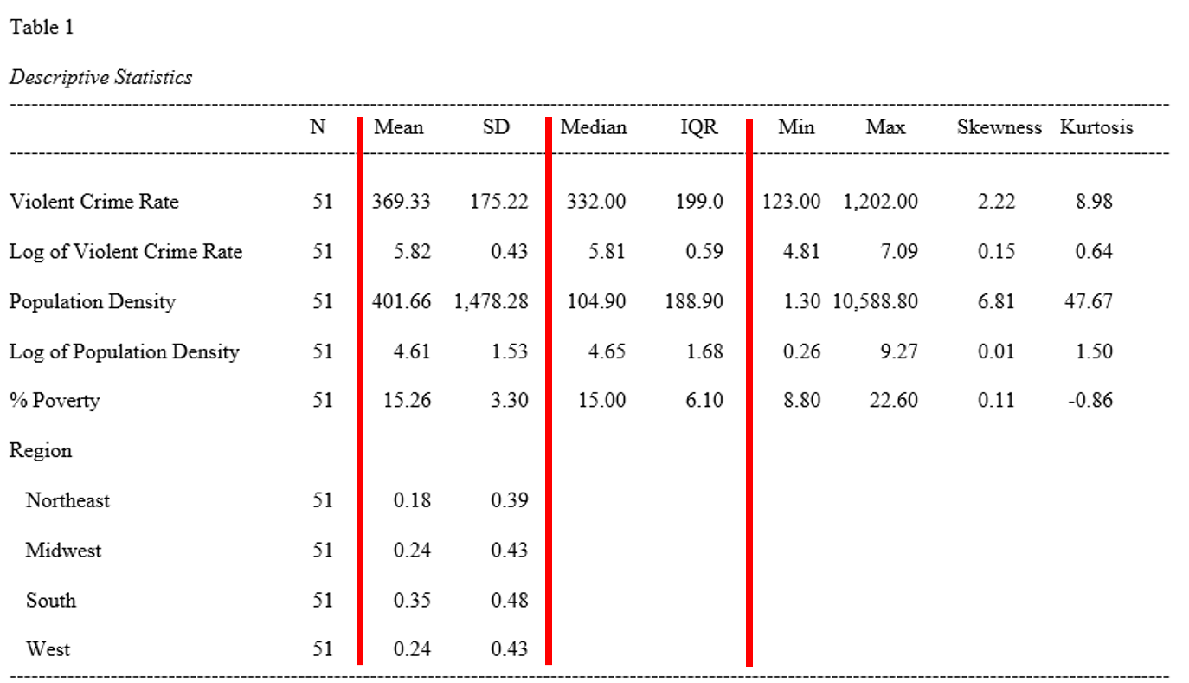
Group like with like

Slide 5
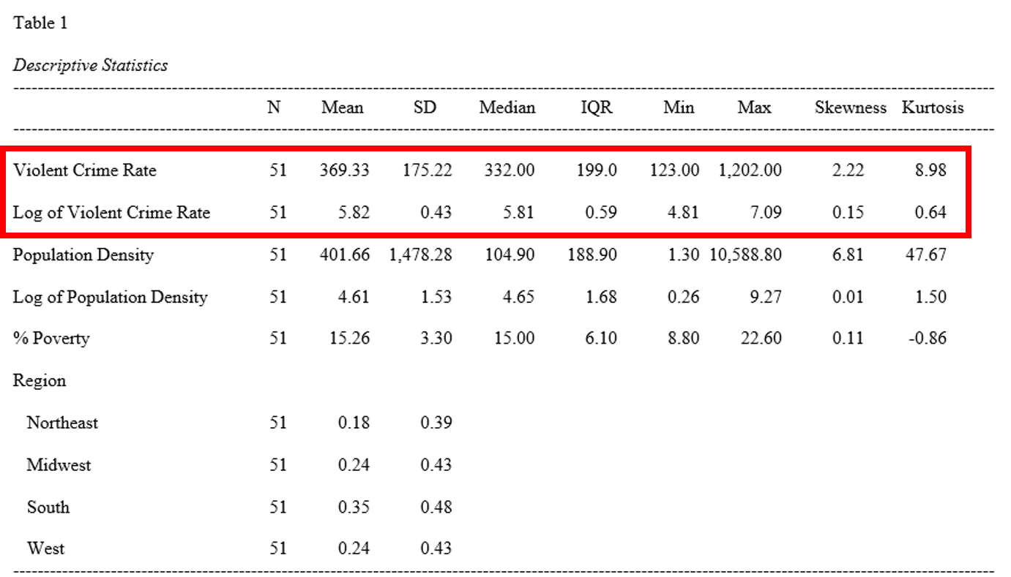
Make a decision about transformations

Slide 6
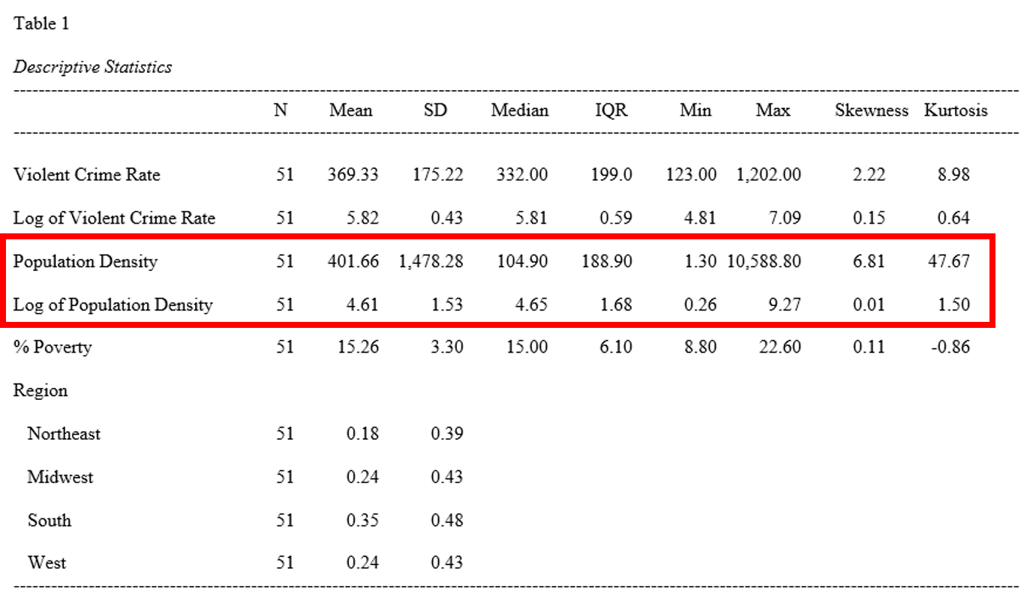
Make a decision about transformations

Slide 7
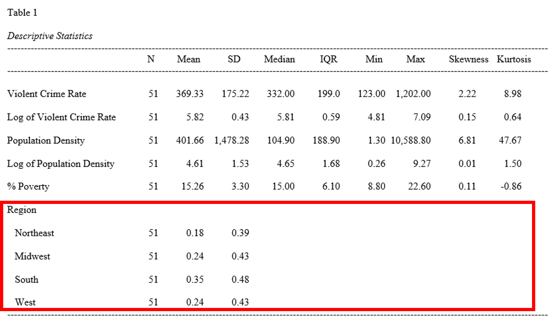
Binary variables should be reported simply

Slide 8
The End

