Slide 1
DESCRIPTIVE STATISTICS FOR NUMERIC DATA in spss and pspp Part II: POSITIONAL MEASURES
Richard Lee Rogers
Last Update: January 24, 2017

Slide 2
The Series
Ways to obtain and graph descriptive statistics in SPSS and PSPP (Parts I and II)
Arithmetic measures, including the mean and the standard deviation (Part I)
Positional measures, including the median and interquartile range (Part II)
Reporting descriptive statistics in an APA table (Part II)

Slide 3
Definitions
Arithmetic measures: Determined using arithmetic operations (e.g., addition, subtraction, multiplication, and division)
Positional measures: Determined by where the number sits in the distribution.
Measure of Measure of
Central Tendency Dispersion
Arithmetic Mean Standard deviation
Position Median Interquartile range

Slide 4
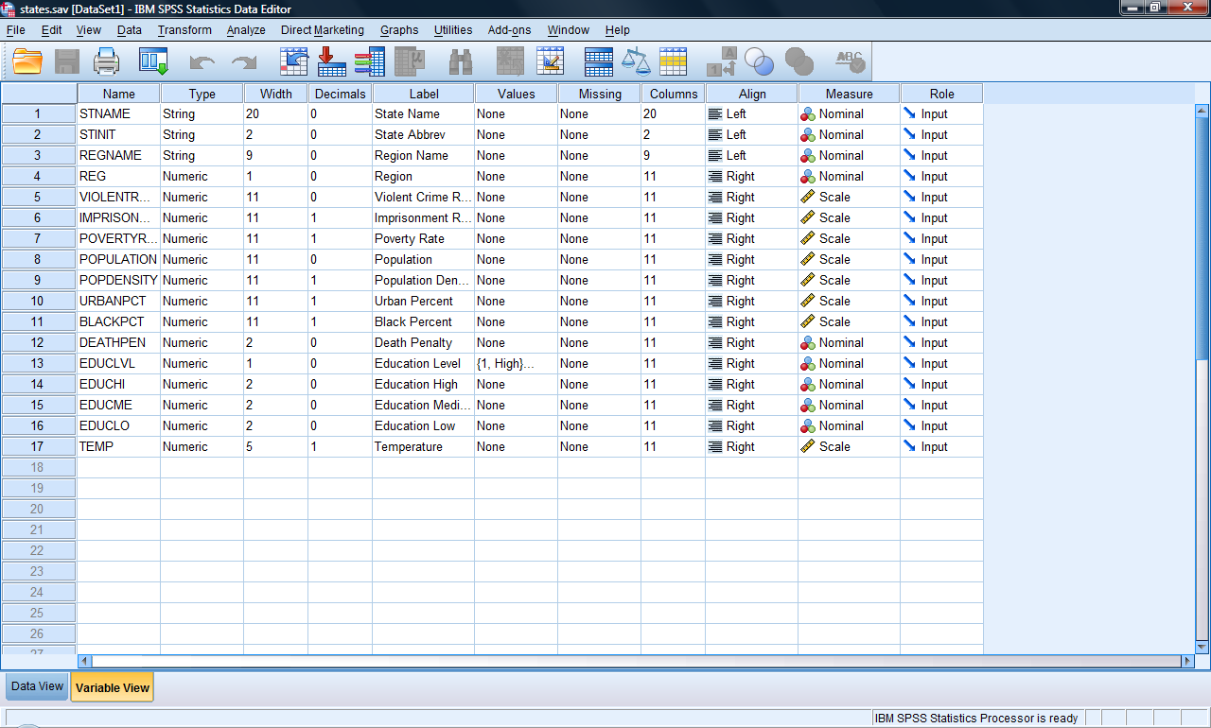
Example: State-Level Data

Slide 5
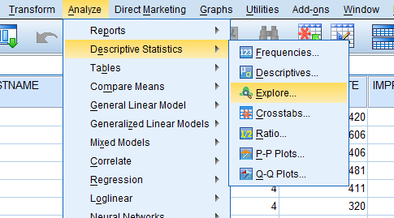
Analyze > Descriptive Statistics

Slide 6
Which Command?
Explore: More detail than Frequencies, but cases are removed if missing values are present in any of the study variables.
Frequencies: Less detail than Explore, but can run multiple variables without worrying about cases being removed for missing values. In any of the study variables.

Slide 7
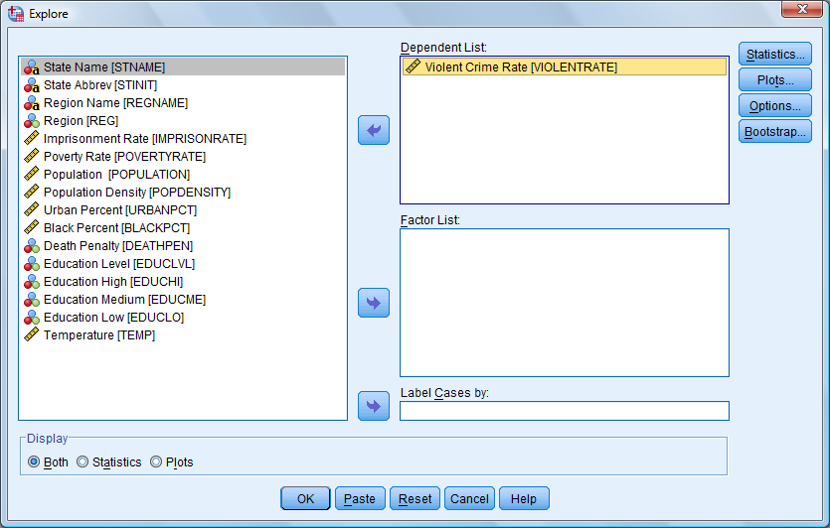
1. Select Variables
use the upper toggle switch

Slide 8
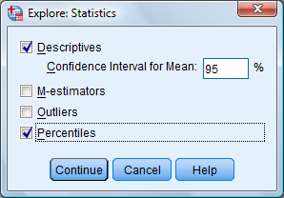
2. Select Statistics (SPSS)

Slide 9
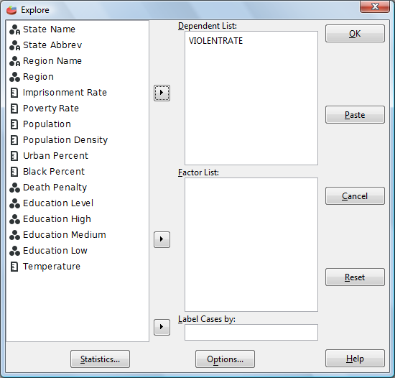
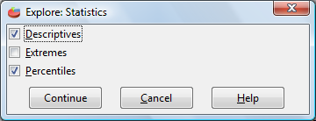
2. Select Statistics (PSPP)

Slide 10
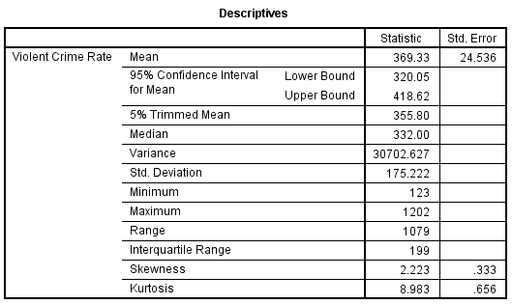
Descriptives Table

Slide 11
Percentiles Table

Slide 12
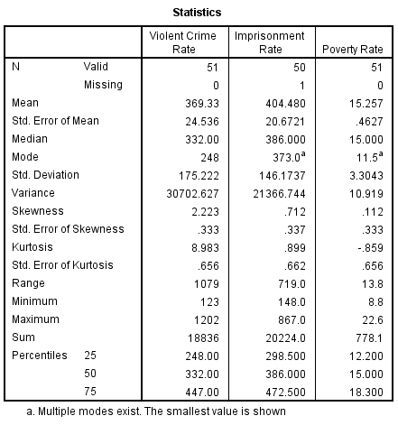
Frequencies Output

Slide 13
Five-Number Summary
Minimum
25th percentile
Median (50th percentile)
75th percentile
Maximum

Slide 14
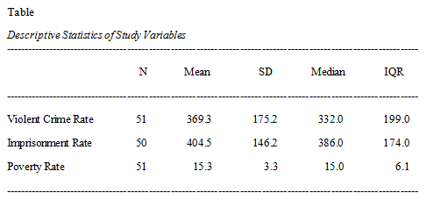
APA-Style Table

Slide 15
APA-Style Table: Arithmetic Measures

Slide 16
APA-Style Table: Formatting

Slide 17
The End
Ways to obtain and graph descriptive statistics in SPSS and PSPP (Parts I and II)
Arithmetic measures, including the mean and the standard deviation (Part I)
Positional measures, including the median and interquartile range (Part II)
Reporting descriptive statistics in an APA table (Part II)

